Slide 1
Design Flow (Cell Base)
郭昱 ivan010517@gmail.com
黃宥翔 chris900623@gmail.com
2024 ALU / HDL

Slide 2





Outline
RTL code
Logic Synthesis
Gate Level Netlist
APR
Layout
Tape-out
Chip

Slide 3
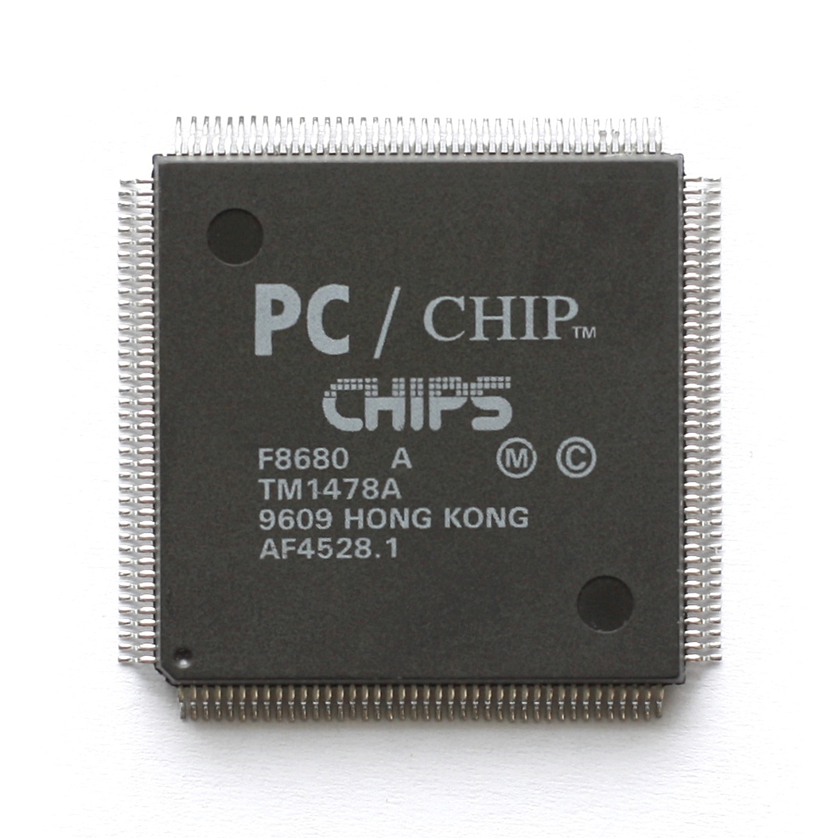

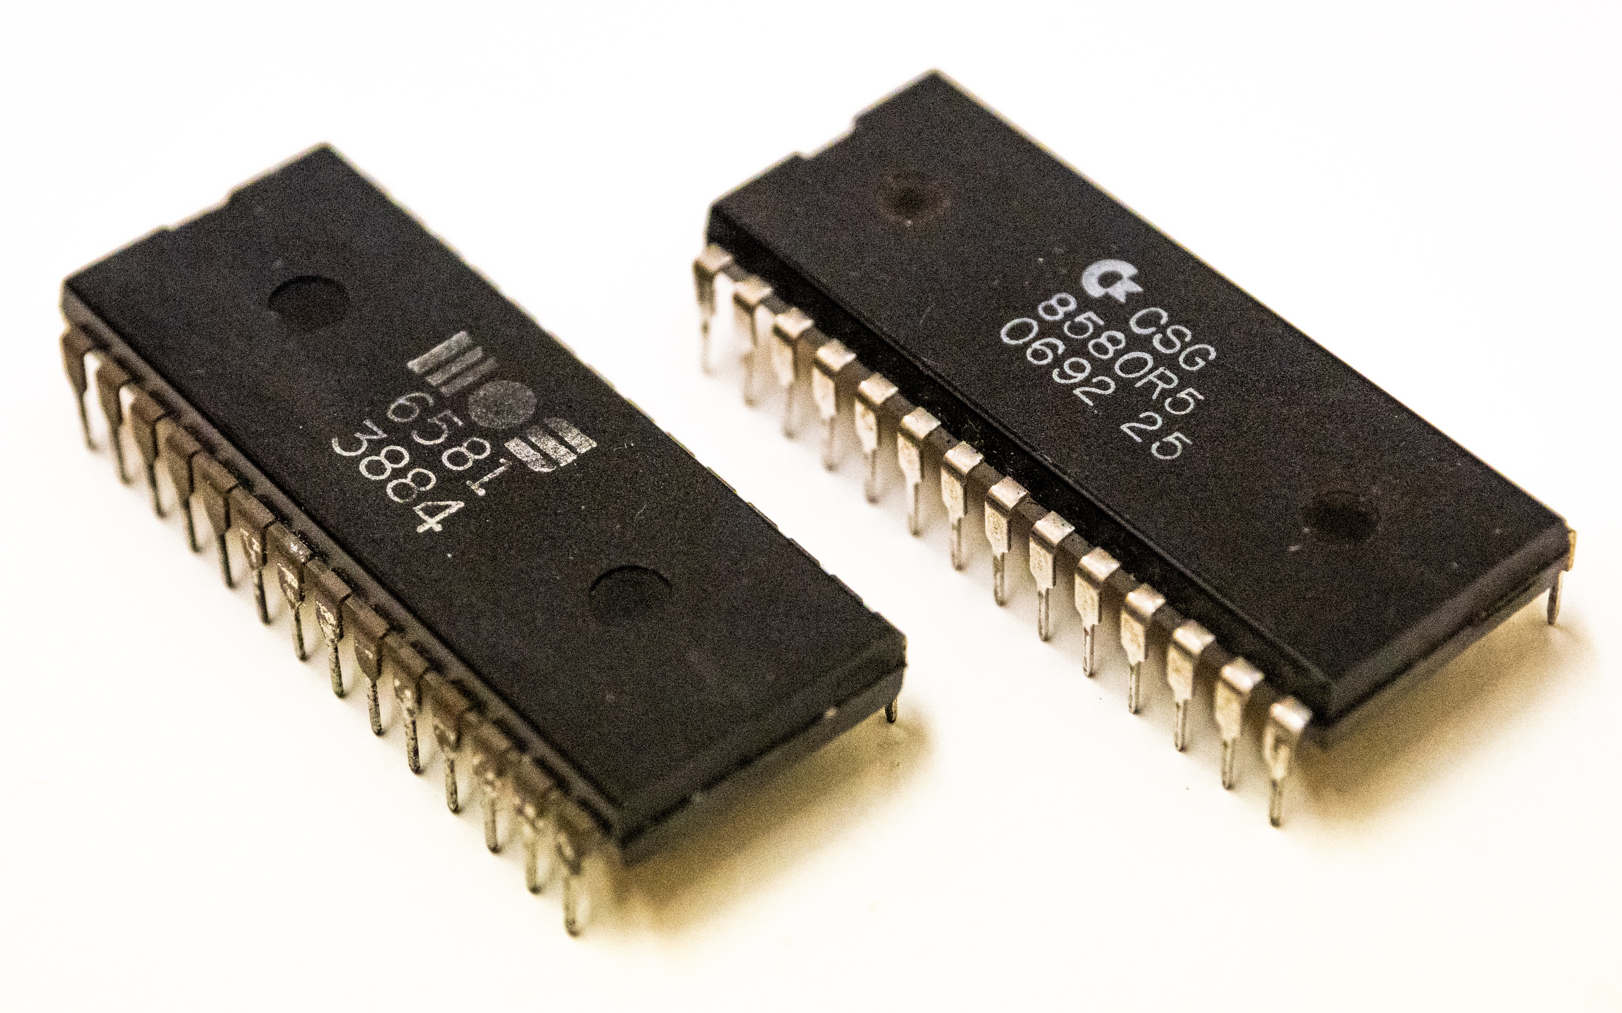





Chip
RTL code
Logic Synthesis
Gate Level Netlist
APR
Layout
Tape out
Chip

Slide 4




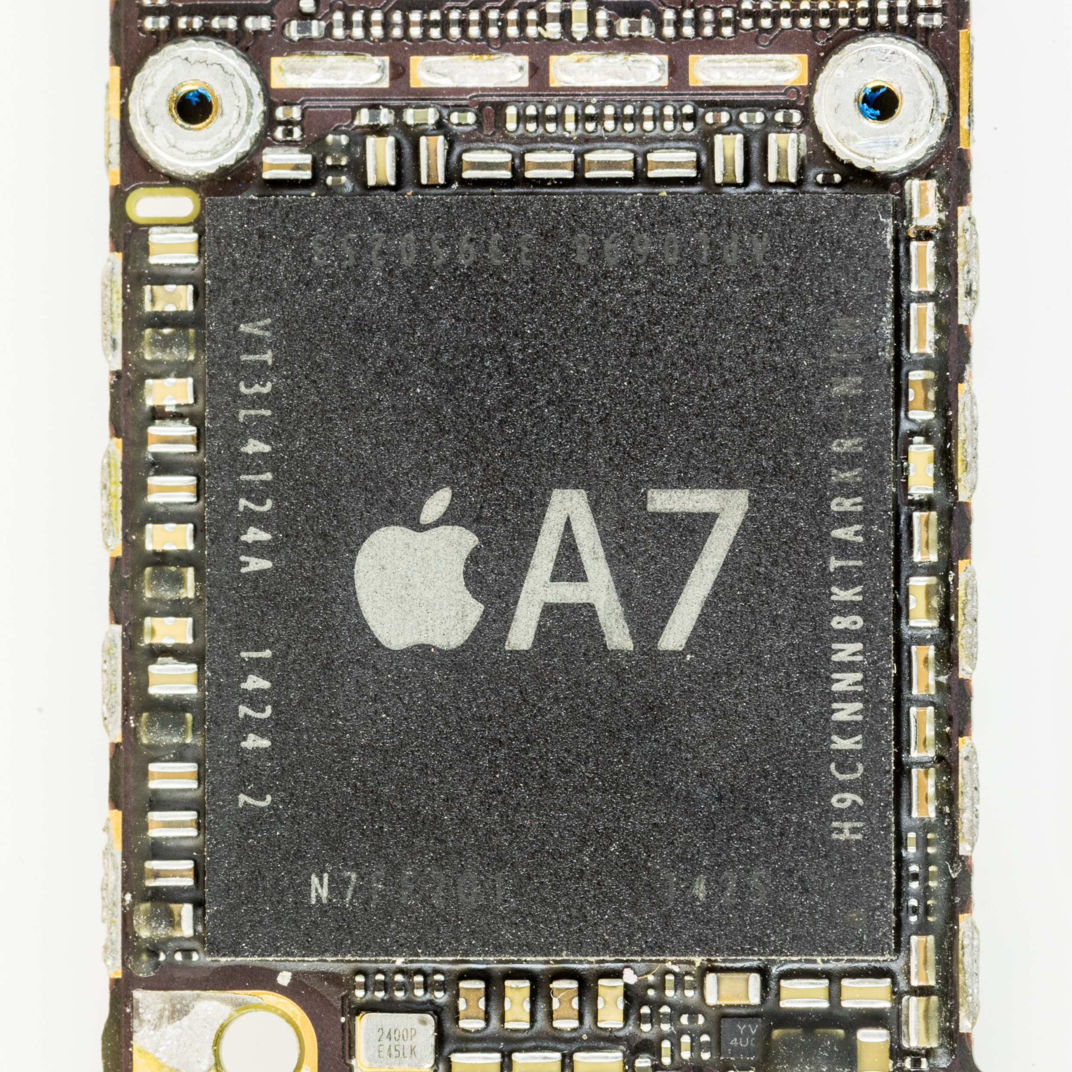



Tape-out
RTL code
Logic Synthesis
Gate Level Netlist
APR
Layout
Tape-out
Chip

Slide 5
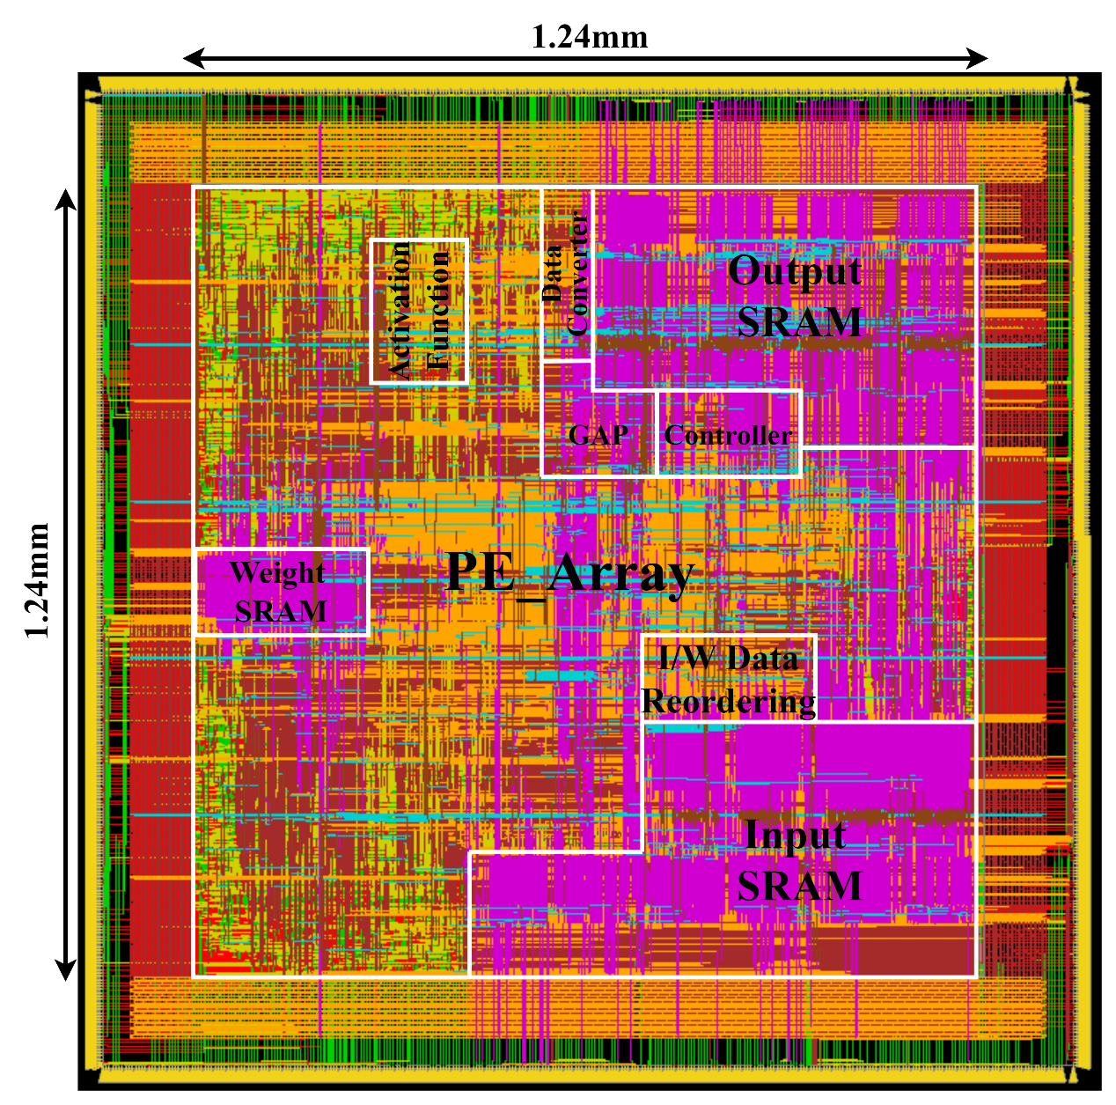

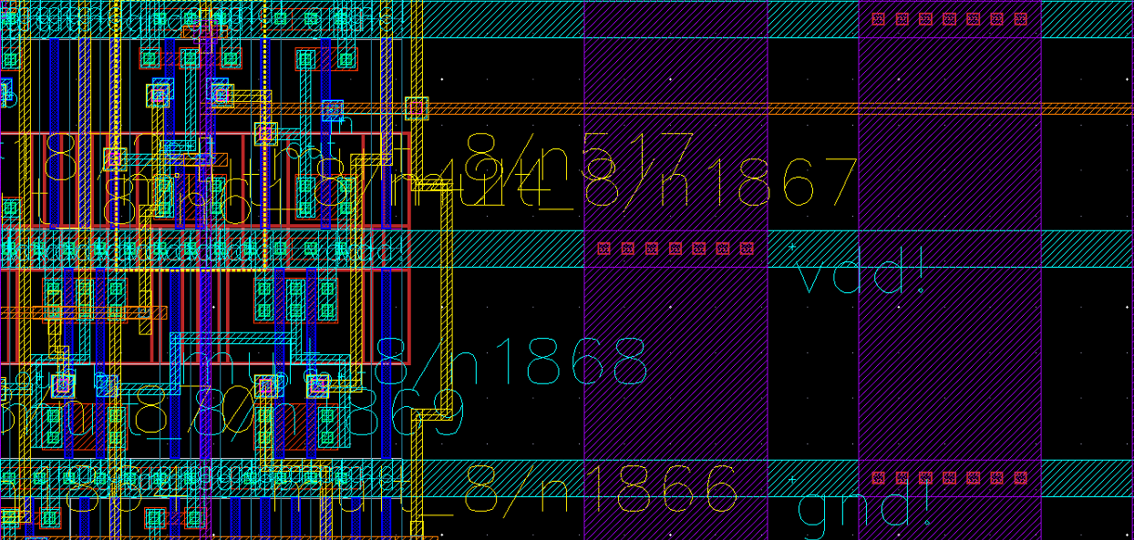

Layout
RTL code
Logic Synthesis
Gate Level Netlist
APR
Layout
Tape out
Chip

Slide 6
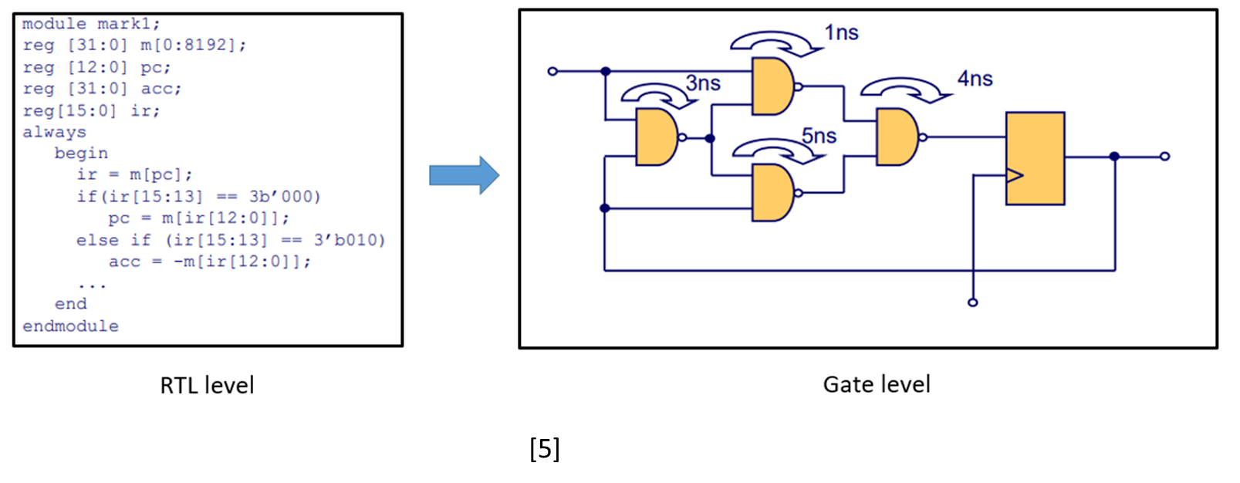

APR
RTL code
Logic Synthesis
Gate Level Netlist
APR
Layout
Tape out
Chip

Slide 7

Gate Level Netlist
RTL code
Logic Synthesis
Gate Level Netlist
APR
Layout
Tape out
Chip

Slide 8


Logic Synthesis
RTL code
Logic Synthesis
Gate Level Netlist
APR
Layout
Tape out
Chip

Slide 9

RTL code
RTL code
Logic Synthesis
Register-Transfer Level Code
Hardware Description Language
Ex : Verilog, VHDL
Gate Level Netlist
APR
Layout
Tape out
Chip

Slide 10
Design Flow
RTL code
Logic Synthesis
Gate Level Netlist
APR
Layout
Tape-out
Chip

Slide 11

1. Design Your Circuit by code
RTL code
Verilog
Logic Synthesis
Gate Level Netlist
APR
Layout
Tape-out
Chip

Slide 12

2. Pre-Simulation
VCS, nWave, Verdi
RTL code
Logic Synthesis
Gate Level Netlist
APR
Layout
Tape-out
Chip

Slide 13


3. Logic Synthesis
RTL code
Logic Synthesis
Design Compiler
Gate Level Netlist
APR
Layout
Tape-out
Chip

Slide 14

4. Post-Simulation
RTL code
Logic Synthesis
Gate Level Netlist
VCS, nWave, Verdi
APR
Layout
Tape-out
Chip

